Slide 1



The Taylor Assessment
Internal Product Overview
Handbook
*For internal use only

Slide 2

Contents
How the Taylor Assessment Will Help You
3
How the Taylor Assessment Helps Clients
4
Using the Taylor Assessment for Recruitment
14
Understanding the Report
17
Commission and Pricing
23
Additional Resources
27

Slide 3
The Taylor Assessment will help you
1. Differentiate ZRG from competitors and win more searches
2. Improve the quality of your searches
3. Increase the stickiness of the candidates you place
4. Position you/ZRG as long-term talent and strategic advisor

Slide 4

HOW THE TAYLOR ASSESSMENT HELPS CLIENTS

Slide 5
The Challenge & Opportunity
RIGHT PEOPLE
Most clients know that culture matters. They want to build the right culture to help them succeed in their business goals and to future proof their organization. To do that, they know they need to have the right people. The larger the organization, the more important it is to retain the ability to innovate and adapt, so hiring for culture contribution increases in importance.
New hires are then one of the key levers at organization’s disposal to help them build the culture they want.
But predicting who the ‘right people’ will be is difficult. Even after a job interview, it is difficult to predict how a candidate is going to contribute or not contribute to the culture that they are trying to build.
There are very few tools on the market that enable clients to do that, so they tend to rely on less accurate means, like their own gut feel or personality assessments which are not designed for this purpose.
We hear hiring managers say that they really need is an objective and systematic way of measuring a person’s culture contribution
RIGHT CULTURE
BUSINESS GOALS
FUTURE PROOF

Slide 6
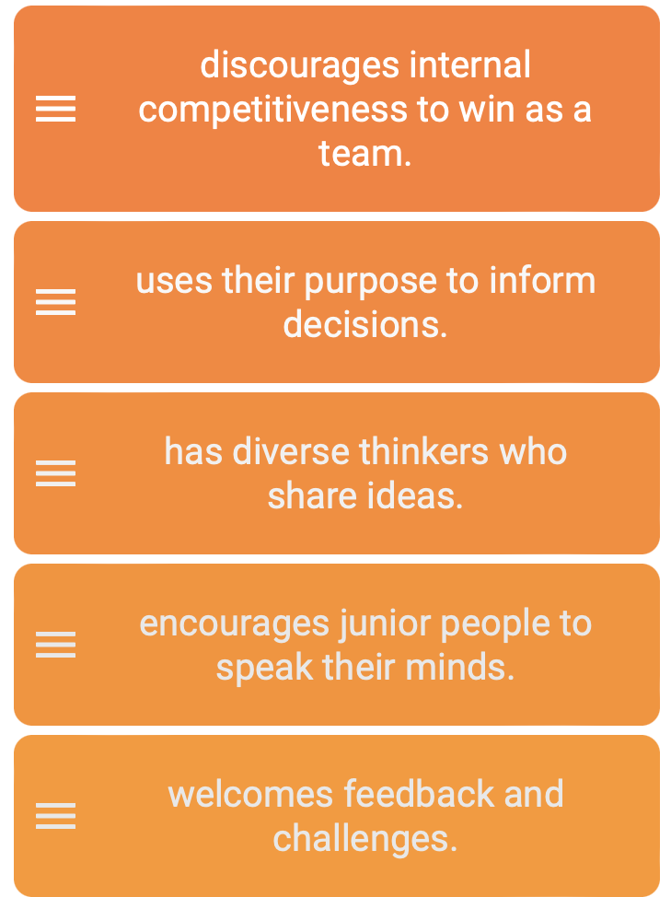
Introducing the Taylor Assessment
Example Question
Our 30-minute online assessment tool identifies the kind of company culture that a person is likely to be attracted to, to thrive in, and to build around them.
It does this by having respondents identify the behaviors they most prefer and are motivated by in the context of work; the stronger the preference, the more likely they are to demonstrate that behavior at work and encourage it in others.
An innovative ranking methodology (image on right) asks people to rank exclusively positive statements from most-to-least preferred in response to a series of business-oriented prompts.
This approach:
Mirrors the way that people make trade-offs in real life between competing commitments, which helps predict actual behaviour and the kind of contribution a person will make to a company and its culture.
Reduces the risk of respondents gaming the assessment or giving socially desirable responses.
The final results and the debriefs we provide are often described as a rich source of insight for both client and candidate.
I want to work for a company that…

Slide 7
Key Features
The Taylor Assessment is unique in 4 different ways. They are:
1
CREATED BY CULTURE EXPERTS
2
3
INNOVATIVE RANKING SYSTEM
4
CAPTURES HOT TOPICS
BUSINESS ORIENTED
Based on our more than 30 years’ experience and the behaviors we know matter to companies and that are critical to the cultures they want to build.
Analyses peoples’ potential contributions specifically within the corporate context, which increases the relevance, applicability, and overall usefulness of the insights.
It replicates how people make trade-offs in real-life, which allows us to better predict how that person may behave and contribute to the culture.
Capturing inclusion, humility, constructive challenge, sustainability and being values-led can fast-track culture change in ways that few other assessments can match.

Slide 8






Our 6 culture archetypes and 30 anchor behaviors
ACHIEVEMENT
CUSTOMER-CENTRIC
ONE-TEAM
INNOVATION
GREATER- GOOD
PEOPLE- FIRST
Results Orientation
Commerciality
Accountability
Risk Mastery
Prioritization
Customer Orientation
Curiosity
Humility
Market-Driven
Customer Empathy
Generosity
Openness
Collaboration
Transparency
Constructive Challenge
Courage
Learning
Experimentation
Continuous Improvement
Agility
Values-led
Purpose-led
Sustainability
Long-term Thinking
Community Orientation
Care
Fairness
Coaching
Inclusion
Empowerment

Slide 9
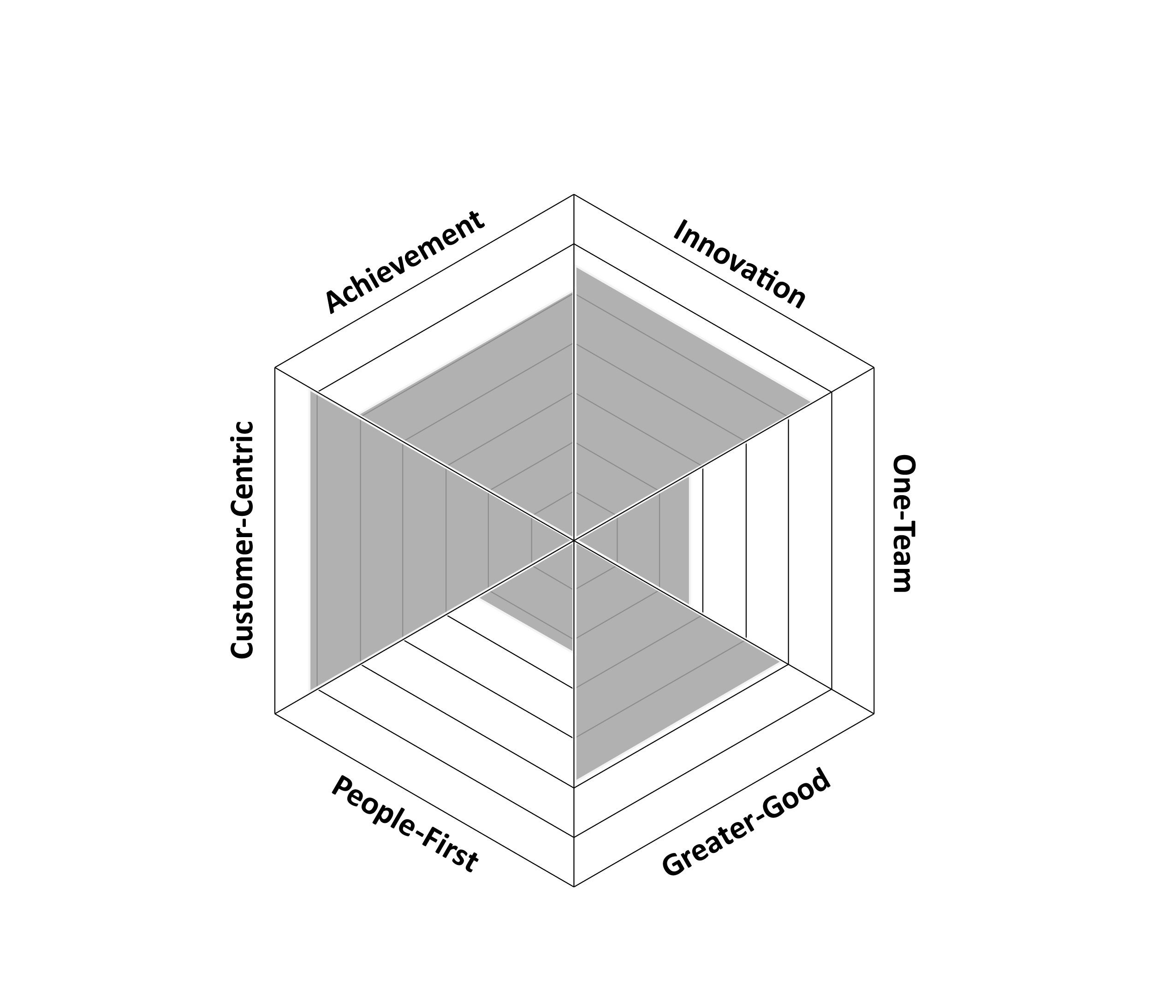
The Culture Frameworks we use
The Taylor Assessment scores each candidate on 30 anchor behaviors that are divided evenly across 6 culture archetypes (5 behaviors per archetype).
These frameworks represent what we’ve heard client companies say they most value and/or most want to see in their company cultures.
No archetype is better or worse than any other; each represents a distinct set of behaviour patterns that can characterize a company culture as well as a person’s natural behavioral tendencies.
While the Taylor Assessment is not a capabilities test; its results allow us to make predictions to improve recruitment decisions, guide leadership development, and build more effective teams.
Developed in partnership with PsyNet, a leading psychometric test developer, the assessment is robustly constructed for strong validity and reliability.

Slide 10

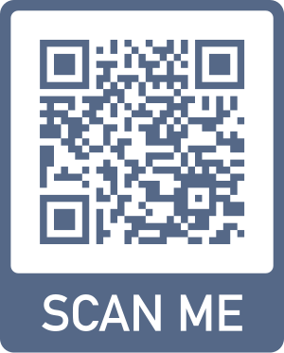
The Archetypes Video

Slide 11
The Taylor Assessment measures ‘Culture Contribution’
Definition. ways that an individual can enhance the company culture or move it forward
Future-oriented
Looks at target profile, but also beyond it
Reduces bias to hire people who are ‘like me’
Focuses on enhancement rather than status quo
Increases diversity and, thus, performance
Definition. degree to which a person’s values and behavioural preferences align with the company’s
Past-oriented
Looks only at current profile
Increases bias to hire people who are ‘like me’
Focuses on status quo rather than enhancement
Reduces diversity and, thus, performance
✓
x
Culture Contribution
Culture Fit

Slide 12
3 Main Applications
LEADERSHIP
ASSESSMENT & DEVELOPMENT
1
RECRUITMENT
2
3
TEAMBUILDING

Slide 13
The Taylor Assessment can also help clients…

Slide 14
USING THE TAYLOR ASSESSMENT FOR RECRUITMENT

Slide 15
Overview of the process
What are we hiring for?
Search strategy
Taylor Assessment
Interview probes
Zi Score
Select Candidate & Onboarding
WTT or ZRG Superuser leads 60-minute conversation with client to define the company’s target culture profile
Exactly as you do today
Candidates History to Role/Mandate
Similar/ dissimilar size, stage, challenge factors
Shortlisted candidates take 30-minute online assessment
You receive the Individual and Cross-Candidate reports
Client debrief on slate by WTT or ZRG Superuser
Candidate debrief (optional)
Probe TA results in interview
Draw from bank of questions per archetype and behavior
Can be used by ZRG and client
TA Score is integrated into Zi

Slide 16
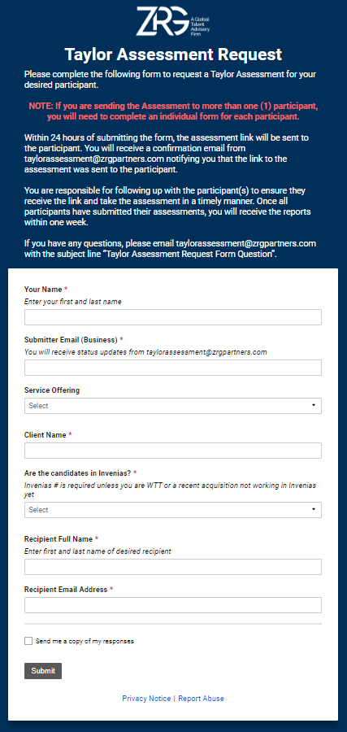
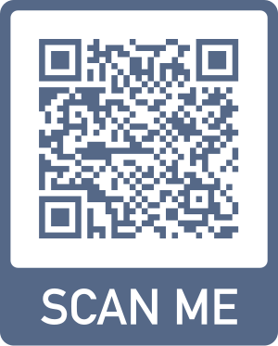
A ‘How-To’ Recruitment Scenario
TA Request Form
To use the Taylor Assessment for recruitment, you must follow the following five steps:
You complete a Taylor Assessment request form for all shortlisted candidates and inform them that they will then receive a link to complete the assessment within 24 hours.
If the candidate has not completed the assessment within 72 hours, our administrator will send an email reminder.
As each candidate completes the assessment, you will receive a written report with each candidate’s individual detailed results. Once all candidates have completed the assessment, you will receive the Cross-Candidate Comparison report to setup the client debrief.
You would then schedule this debrief with the client, and if the client requests it, a separate debrief with the candidate (at an additional cost). These are conducted by a trained Taylor Assessment specialist who will support interpretation of the results.
You provide the client with a set of tailored interview questions that can be used by either/both the company and the MD depending on how you have worked with the client to define this part of the process.

Slide 17
UNDERSTANDING THE TAYLOR ASSESSMENT REPORT

Slide 18
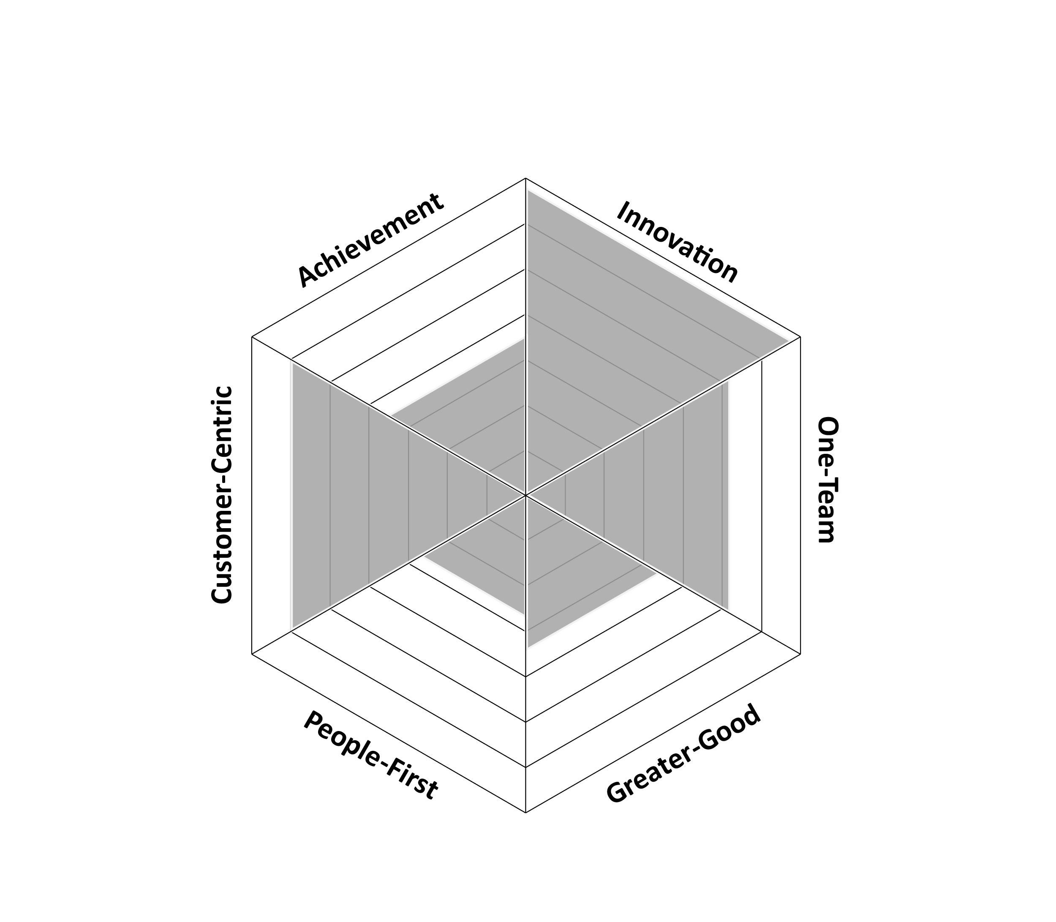
Sample Results by Archetype
Achievement
Client’s target archetype
The gray triangles represent the person’s results on each archetype
Each score represents how candidates ranked in all responses linked to that archetype. It therefore indicates the strength of that person’s preference for that archetype and how likely they are to demonstrate behaviors related to it at work.
All candidates will have a mix of high, medium and low scores. In this example, the candidate ranks highly for innovation and customer centricity.

Slide 19
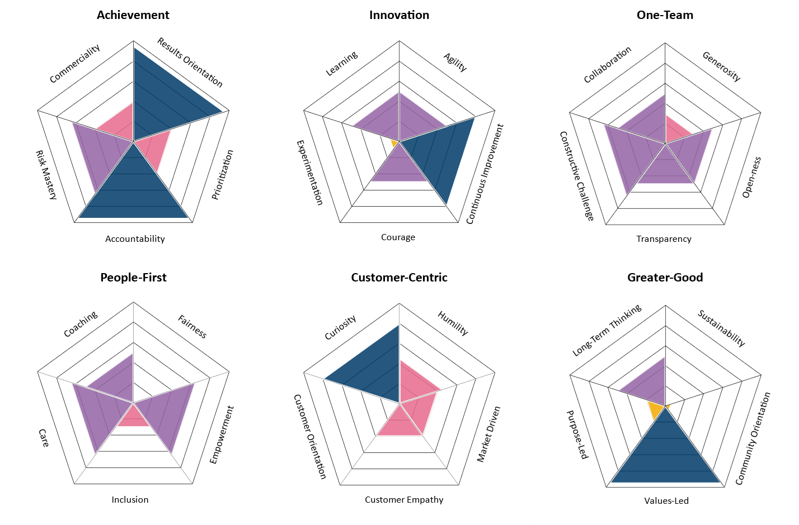
Sample Results by Anchor Behavior
Individual preference
 | High
 | Medium high
 | Medium low
 | Low

Slide 20
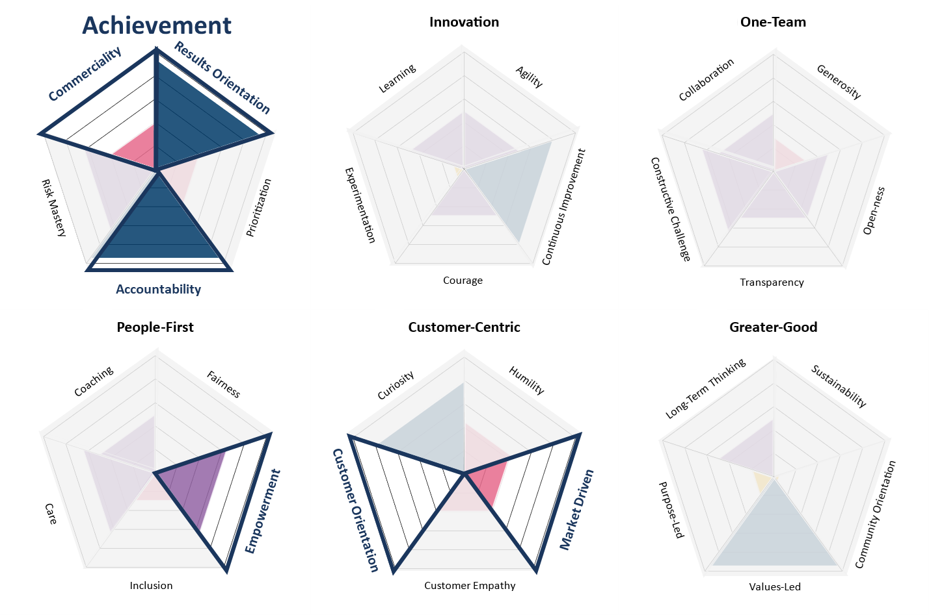
Sample Results vs. Target Culture Profile
Target Archetype(s)
Achievement
Target Anchor Behaviors
Commerciality
Results Orientation
Accountability
Customer Orientation
Market Driven
Empowerment

Slide 21
Sample Cross-Candidate Comparison with Impact Score
TARGET BEHAVIORS | INDIVIDUAL PREFERENCE LEVELS
Core contributions | Candidate 1 |  | Candidate 2 |  | Candidate 3 |  | Candidate 4
Accountability (Achievement) | High |  | High |  | Medium high |  | Medium high
Commerciality (Achievement) | Medium low |  | High |  | Low |  | Medium high
Results Orientation (Achievement) | High |  | High |  | High |  | High
Market Driven (Customer-Centric) | Medium low |  | High |  | Low |  | High
Customer Orientation (Customer-Centric) | Low |  | High |  | High |  | High
Empowerment (People-First) | Medium high |  | Low |  | High |  | High
Complementary Contributions | Curiosity Risk Mastery |  | Curiosity Customer Empathy Prioritization |  | Risk Mastery Customer Empathy |  | Coaching Curiosity Customer Empathy
Potential Risks | Prioritization |  | Risk Mastery |  | Prioritization |  | Prioritization Risk Mastery
CULTURE IMPACT SCORE |  | 7.4 (#3) |  | 9.0 (#1) |  | 6.6 (#4) |  | 8.6 (#2)
High
Medium high
Medium low
Low
Your target culture is comprised of 4 to 6 core behaviors
Behaviors not part of the target culture that could enhance it (Complementary Contributions) or put it at risk (Potential Risks)
High
Medium high
Medium low
Low

Slide 22
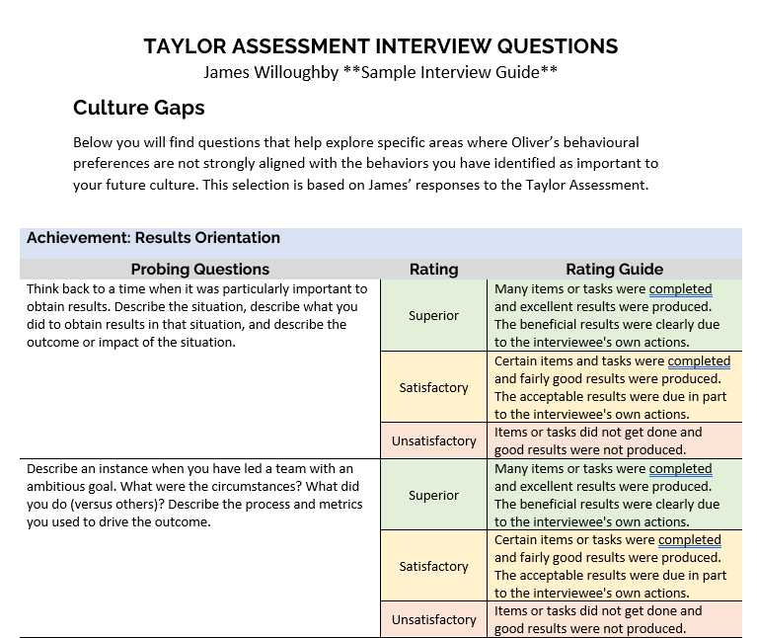
Sample Interview Probing Questions
We will provide a set of custom interview questions based on an individual’s Taylor Assessment results
They are designed primarily to help the interviewer better assess the candidate on behaviours they may have scored low on that are deemed important to the client organization’s target profile and/or culture.

Slide 23
COMMISSION AND PRICING

Slide 24
Taylor Assessment – PPP & Commissions for Search MDs
Revenue credit will be given and Commissions will be paid to Search MDs for originating Taylor Assessment related work
Typical revenue credit model applies:
20% origination credit
30% selling credit (if applicable)
Cross-selling revenue credit applies to up to $1M in Consulting revenue occurring in first 12 months including the first sale, originated by a Search MD
Example: Search uses Taylor Assessment in 2 Searches, 4 candidates in each, and with 12 Internal Leaders
[Example] WTT Engagement |  | $140,800
Origination | 20% | $12,300
Selling/Exec | 80% | $49,200
Taylor Assessment x20 |  | $8,000
First TA Target Definition |  | $7,500
Client Advisory Debrief on Slate x2 |  | $6,800
Candidate Debrief x8 |  | $14,000
Internal Leader Debrief x12 |  | $25,200
 |  | $61,500
Search MD | Revenue Credit |  | $12,300
 | 50% Commissions (or 55% or 60% depending on kicker rate) |  | $6,150

Slide 25
Full Pricing List
Mandatory Components for Recruitment
Target Culture Work/ | Fees USD
1st Taylor Assessment target definition of culture/team | $7,500.00
Simplified target definition if client culture is already fully defined | $3,500.00
Target definition for additional business units, team, roles | $1,700.00
More extensive Target Culture Mapping workshop with senior team | $22,000.00
At least 1 of these 3 options from the ‘Target Culture Work’ section
1
Survey Completion
Taylor Assessment (per participant) | $400.00
Report Debriefs & Advisory Work
Client Advisory Debrief on Slate (multiple candidates) including candidate recommendations (high-med-low) | $3,400.00
1:1 Candidate Participant Debrief 60' (hiring) | $1,700.00
1:1 Leader Participant Debrief 90' (for Leadership Development) | $2,100.00
New hire/leader follow on coaching | TBA
Accreditation and Train the Trainer (only offer after 6-month trial period)
Train the Trainer Part II 1.5 days 4-8 participants (Slate debrief) | $37,500.00
Additional participants; up to 8 more (price per pax) | $3,000.00
Train the Trainer Part II 1.5 days 4-8 participants (Candidate debrief) | $37,500.00
2
The Taylor Assessment itself
3
Client Advisory Debrief

Slide 26
Two Example Pricing Scenarios
Client A
Client B
Client A has shortlisted 5 candidates for a senior role, but they’ve never defined the kind of culture they want to build.
In response, you propose
1st Taylor Assessment Culture Definition’ ($7500)
Taylor Assessment for 5 participants ($2000)
1 Client Advisory Debrief ($3400).
Client has also requested each candidate is provided an individual debrief, even if they are unsuccessful ($1700 x 5 = $8500)
Client B has a very clear idea of the culture they want and are seeking to fill 2 roles—each in a different department.
They have 5 shortlisted candidates for each role and do not want to offer them individual debriefs at this stage.
In response, you propose
1x ‘Simplified Target Definition’ ($3500) for the first business unit.
1x ‘Target Definition for Additional Business Units’ ($1700) for the second business unit.
10x Taylor Assessments ($4000)
2x Client Advisory Debriefs ($7800)

Slide 27
Additional Resources
How to request it
Access the request form via QR code at bottom-right or by clicking this direct Smartsheet link
Product Support
Owen Handy, Brett Bolt, Andres Fossas
taylorassessment@zrgpartners.com
Marketing Support
Mark Cummings mcummings@zrgpartners.com
Steve McLay steve.mclay@walkingthetalk.com
What You Can Do Now
Begin offering the Taylor Assessment to your clients
Take the Taylor Assessment yourself

